Slide 1
The Singapore Story: Data Governance for a Digital Economy and Society
Yeong Zee Kin
Assistant Chief Executive (Data Innovation & Protection Group), Infocomm Media Development Authority (IMDA), Singapore;
Deputy Commissioner, Personal Data Protection Commission (PDPC), Singapore; and
Chief Executive, Singapore Academy of Law

Slide 2
Data convergence in the ASEAN region
ASEAN Framework on Personal Data Protection (2016)
“Baseline principles” - based on principles of the OECD Privacy Guidelines and the APEC Privacy Framework
ASEAN Framework on Digital Data Governance (2018)
“Strategic priorities” – sets out the strategic priorities, principles and initiatives to guide ASEAN member states (AMS) in their policy and regulatory approaches towards digital data governance in the digital economy.
“Governance, controls”
ASEAN Data Management Framework
ASEAN Cross Border Data Flows Mechanism
ASEAN Data Protection and Privacy Forum
ASEAN Digital Innovation Forum
Notes:
2016: ASEAN Framework on Personal Data Protection was developed as a non-binding, baseline set of principles for ASEAN Member States. The framework was modelled closely after principles in the OECD Guidelines and the APEC Privacy Framework.
2018: ASEAN Framework on Digital Data Governance was adopted, comprising of various tracks of work to enhance data management, facilitate harmonization of data regulations and promote intra-ASEAN data flows. The ASEAN Data Protection and Privacy Forum was also established for regulators and policy makers to exchange ideas and develop best practices.
Two other important components that had been developed as part of the Digital Data Governance Framework are the ASEAN Data Management Framework and the ASEAN Cross Border Data Flow Mechanisms.

Slide 3
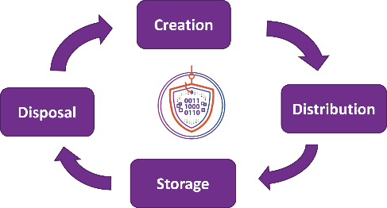
ASEAN Data Management Framework
Data governance and protection throughout the data lifecycle and ecosystem
6 Foundational Components
Across the Data Life Cycle
Governance & Oversight
Policies and Procedural Documents
Data Inventory
Impact/risk Assessment
Controls
Monitoring & Continuous Improvement
Which helps to:
Facilitates trusted data sharing
Identifies right level of protection measures for different types of data
Notes:
Helps policymakers in asean promote a robust digital economy
Support data flows within domestic economy and cross border data flows for companies operating across ams
Helps business operating in asean participate in the digital economy
Establish common language to support data management
Helps all businesses in asean practice data governance throughout their data lifecycle
Provide practical guidance to enable orgs to build their own policies and procedures using risk based data management methodology, in a cost effective manner

Slide 4
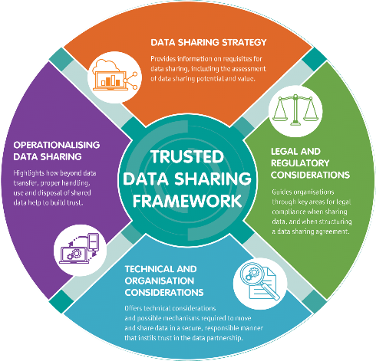
Facilitating data sharing within domestic economy
Trusted Data Sharing Framework
v
Encourage trusted data sharing between businesses and stakeholders by providing a common ‘data-sharing language’.
Appreciate benefits of data sharing
Gain clarity from the information and illustrations presented
Understand key areas of considerations to enable data sharing; and
Kick-start their data sharing journeys or develop their own ideas around data sharing.

Slide 5



ASEAN MCCs for regional cross border data flows
ASEAN Model Contractual Clauses for Cross Border Data Flows
Flexible template*
Businesses do not need to engage in lengthy negotiation for contracts
Common understanding on the responsibility of parties
v
Baseline set of contractual clauses for transferring data within ASEAN
Voluntary adoption, applicable to all AMS with or without Data Protection Authorities (DPAs)
Recognised as a valid mechanism for transfer of data (e.g., Singapore, Philippines)
Who can use?
Any businesses within ASEAN with partner business in another ASEAN country
Support SME adoption and address common transfer scenarios
Easy Adoption
No requirement for new laws
Contractual disputes regarding the MCCs will be resolved in civil courts
*MCCs may be amended so long as it continues to reflect the principles of the ASEAN Framework on Personal Data Protection
Notes:
Contract is the most commonly used transfer mechanism, especially for B2B transfers.
The MCCs are not intended to be used in isolation, but to be used in conjunction with the technical measures, process safeguards and other forms of governance controls recommended in the Data Management Framework.
They are intended to work hand in glove. Some of the obligations established in the MCCs can be implemented through the best practices set forth in the DMF.

Slide 6

ASEAN-EU collaboration for global data transfers
NEW
Joint Guide on ASEAN Model Contractual Clauses and EU Standard Contractual Clauses
Consists of 2 parts:
v
1
Reference Guide
(launched May 2023)
i.e., mapping/comparison table between MCCs and SCCs
Facilitate common understanding of both ASEAN MCC & EU SCCs and ease contractual negotiations between ASEAN-EU business partners
Provide practical guidance that ASEAN businesses can implement to fulfil their contractual obligations when receiving data from EU (and vice versa)
Demonstrate value of ASEAN MCCs as a viable data mechanism and greater adoption of MCCs within ASEAN
2
Implementation Guide
(coming soon)
i.e., practical controls/safeguards to ensure compliance with both sets of clauses (“bridge the gap”)
Notes:
ASEAN MCCs reflect the DP principles of ASEAN Framework on PDP, while EU SCCs are based on the EU GDPR requirements
Both are voluntary sets of clauses that businesses can include in their commercial contracts
Contain similar concepts (e.g., definitions, obligations)
Key differences:
SCCs are standardised/pre-approved, while MCCs can be amended
SCCs more prescriptive, and more mandatory requirements
Reference Guide:
Endorsed by ASEAN Digital Ministers in Feb 2023
Plcy working with EDE, INTL, EU DG JUST on design of publication, Forewords
“Launch” of guide in May 2023, at CPDP conference in Brussels
Implementation Guide (to confirm approach and deliverable with EU DG JUST):
PDP Week in July 2023: Joint workshop with EU to promote awareness/gather use cases for the Implementation Guide
ASEAN Data Protection Privacy Forum (ADPPF) in July 2023: Seek feedback from ASEAN Officials
2nd ADGSOM Leaders Retreat in August 2023: Secure in-principle endorsement for Implementation Guide from ADGSOM
4th ADGMIN in Singapore in 2024 (Final Milestone): Approval of the Joint Guide, which will be updated to include the Implementation Guide

Slide 7
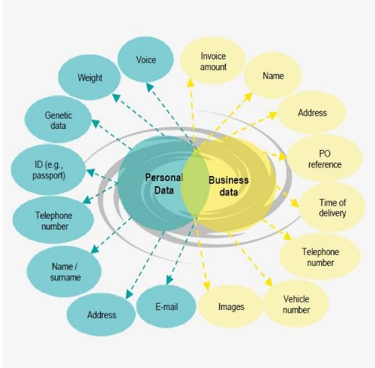
Identifying right level of protection measures for different types of data
Why are we collecting, using and storing this data?
How are we accessing the data?
Who is the employee and department responsible for this data within the company?
What type of data are we accessing (personal or business data)?
Where is the data located?
Notes:
ASEAN Data Management Framework was developed to help companies identify the right level of protection measures for data repositories and assets. It makes recommendations concerning the technical measures for different levels of protection, taking a holistic approach to data governance throughout the data lifecycle – protecting both data at rest, and in transit.

Slide 8

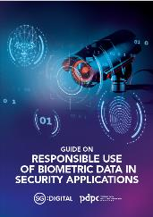
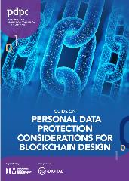

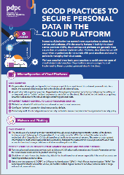
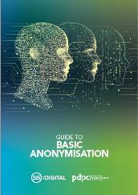
Building competency with tools and resources
New and Updated Guides & Infographics
v
Guide on Data Protection Practices for ICT Systems
Guide on Personal Data Protection Considerations for Blockchain Design
Guide on the Responsible Use of Biometric Data in Security Applications
Guide on Basic Anonymisation
Infographic on Good Practices to Secure Personal Data in the Cloud Platform
Handbook on How to Guard Against Common Types of Data Breaches
More tools and resources can be accessed via www.pdpc.gov.sg

Slide 9
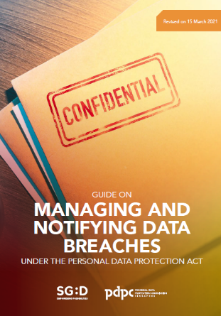
Accountability through a robust data breach management plan
Guide on Managing and Notifying Data Breaches under the Personal Data Protection Act (PDPA)
v
CONTAIN the Data Breach
ASSESS the Risks and Impact
Good practices to help organisations identify and prepare for data breaches with a data breach management plan
Key considerations for organisations in responding to data breaches.
REPORT the Incident
EVALUATE data breach response and take actions to prevent future data breaches

Slide 10
Thank you.
www.pdpc.gov.sg

